Slide 1


Campaign against Genocide War (April 6-12)
Dr Jonathan R Beloff

Slide 2
Recap…
1993 Arusha Accords
Reorganisation of the RPA
3rd Battalion at CND
UNAMIR in Kissimenti
Divisions within FAR
Interahamwe
Delays in implementing Arusha Accords
Tensions are increasing…

Slide 3
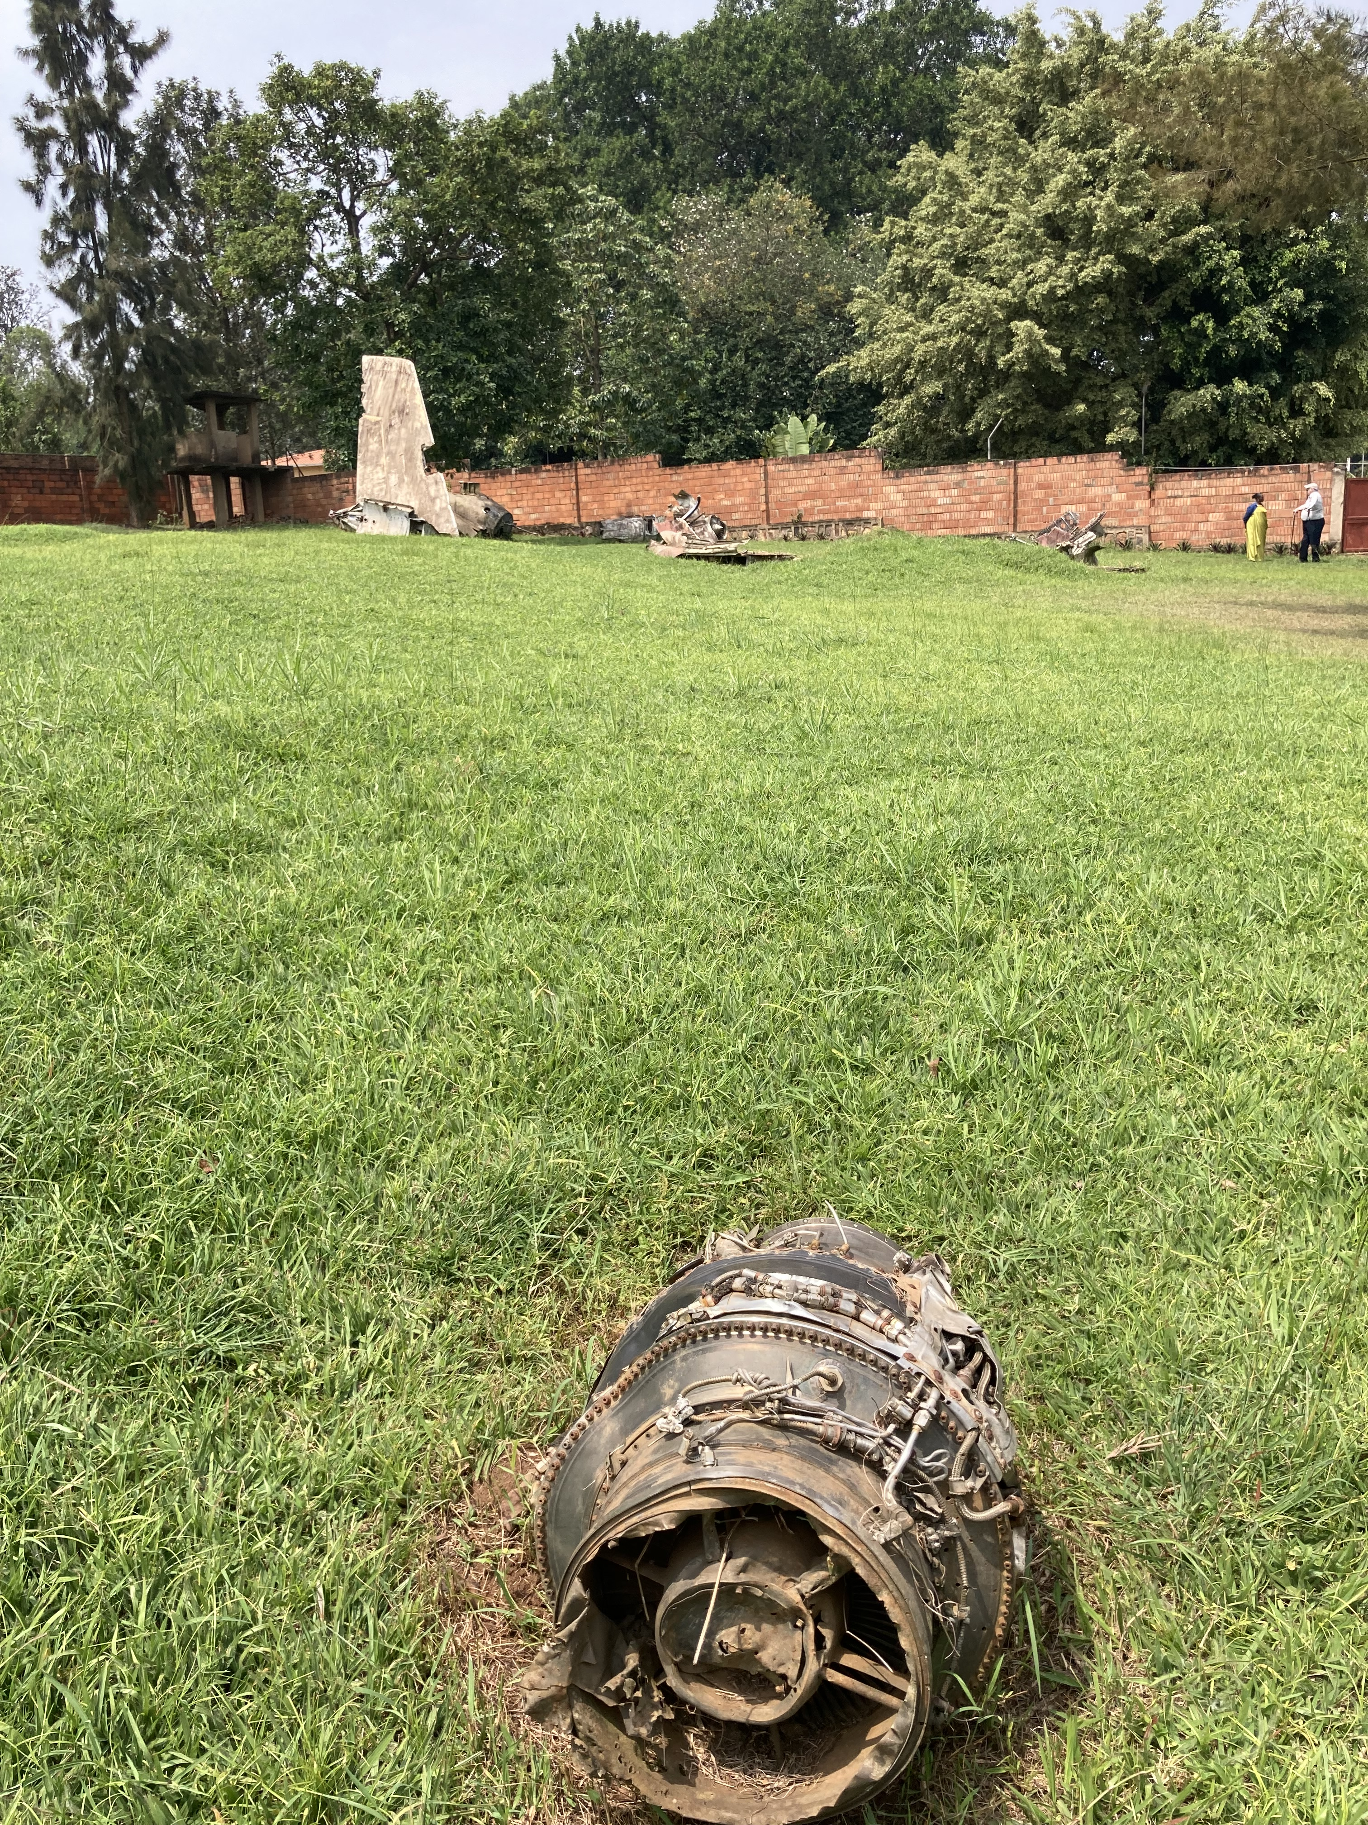
April 6…
-Habyarimana returning to Kigali after meeting with regional leaders
-8:30pm, two Soviet made SA-7 and SA-16/18 strike the Falcon-50
-Beyond Habyarimana:
  Chief of Staff of the Army: Deogratias Nsabimana
  Political Councilor: Juvenal Renzaho
  Chief of Personal security:Cl Elie Sagatwa
  Commander of Presidential Guard: Thaddee Bagaragaza
  Burundi President Cyprien Ntaryamira
-Within 90 mins of crash: roadblocks begin
-Masaka Hill vs Camp Kanombe

Slide 4
April 7
The Akazu/Bagasora’s coup
  Meeting at 10:00pm (April 6) until 2/3:00 am
    Colonel Bagasora
    Major General Augustin Ndindiliyimana
    General Tharcisse Renzahoo
    Ephrem Rwabalinda (Liaison to UNAMIR)
  Agathe Uwilingiyimana and other Hutu moderates targeted
Major General Andrew Kagame’s saving of Minister Vincent Biruta
Dallaire’s (2004) description of those first targeted were moderates
    PL Leader Landoald Ndasingwa
    MDR member Faustin Rucogoza
    PL member Aloys Niyoyita
    MDR leader Faustin Twagiramungu
  The removal of political, economic and social threats to the akazu
Presidential Guard & Interahamwe also targeting Tutsis
Battle at Kimihurura Circle begins
Kayonga receives confirmation of the President’s death and to break out of Parliament (3pm)

Slide 5
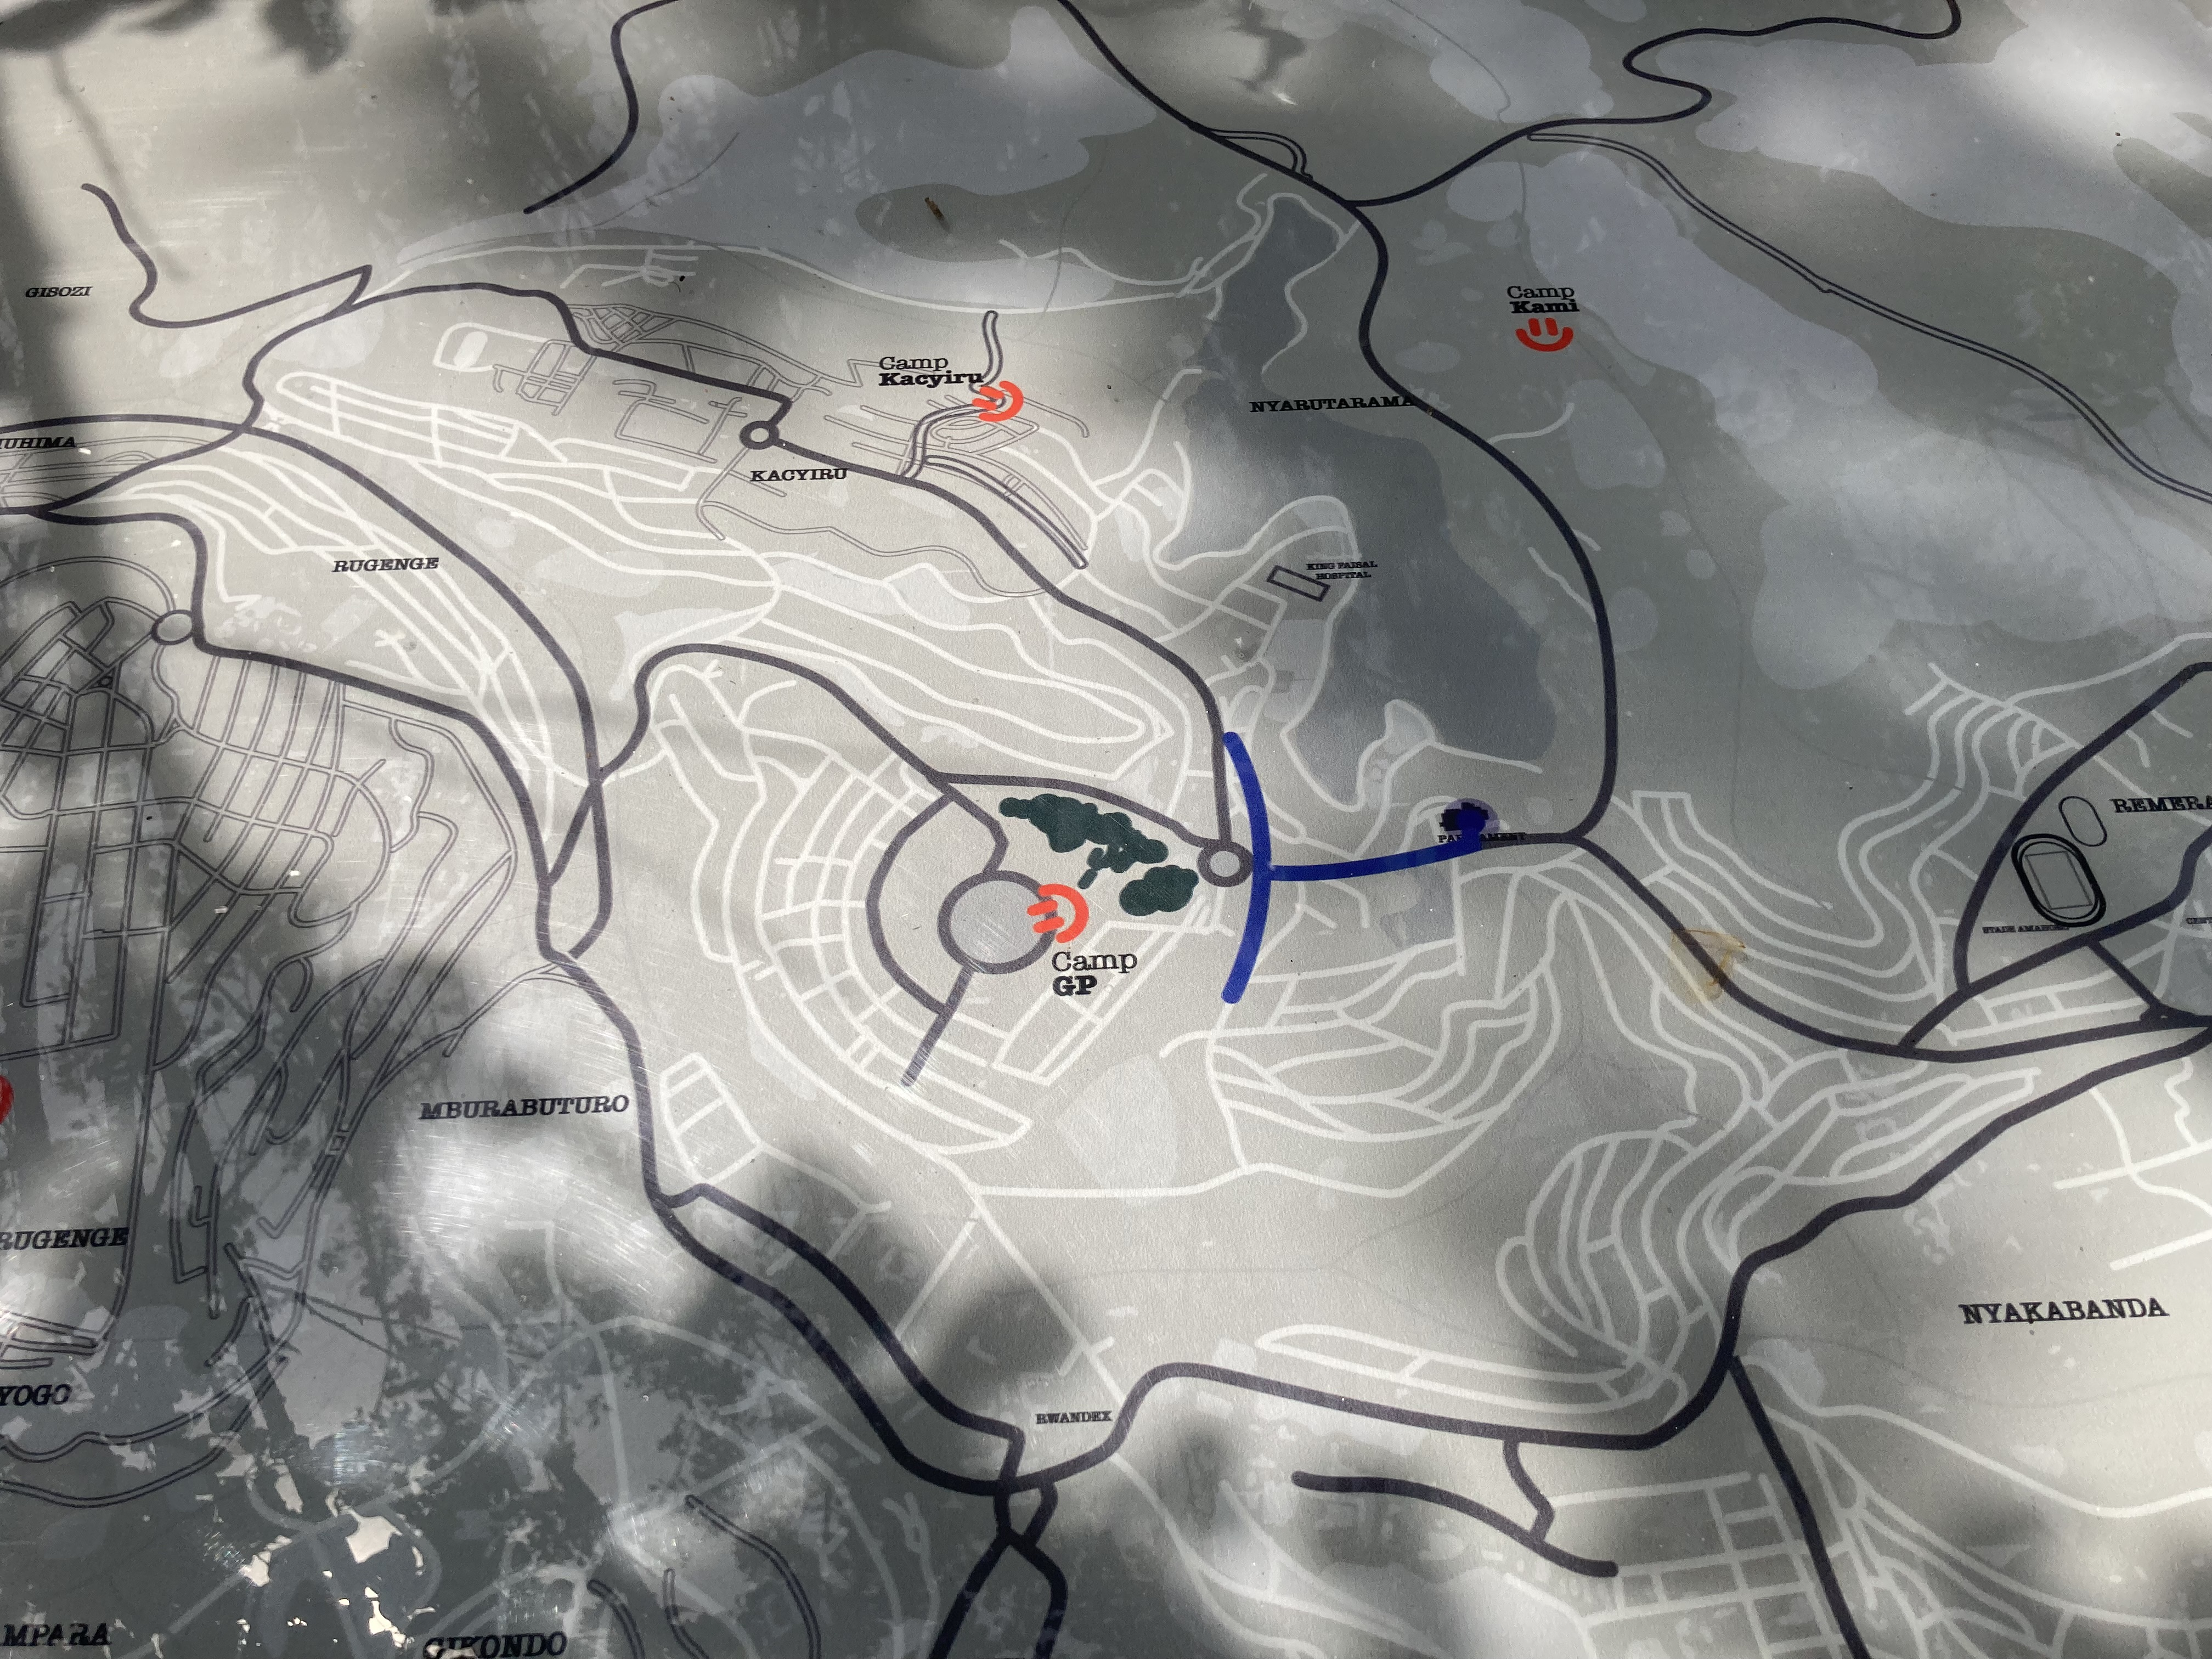
RPA’s 3rd Battalion…
-Just a few months prior, 3rd Battalion received orders of what to do in case the situation destabilised.
-5 Companies:
1.) HQ company to stay at Parliament
2.) Eagle Company to head towards Amahoro Stadium
3.) Simba Company heads north to KG 537 st (Golf course)
4.) Tiger Company head towards Kacyiru
5.) CHUI Company fight Camp Kimihurura
-Alpha (Kaka), Bravo (Dodo) and 59th (Charles Ngoga) head towards Parliament

Slide 6
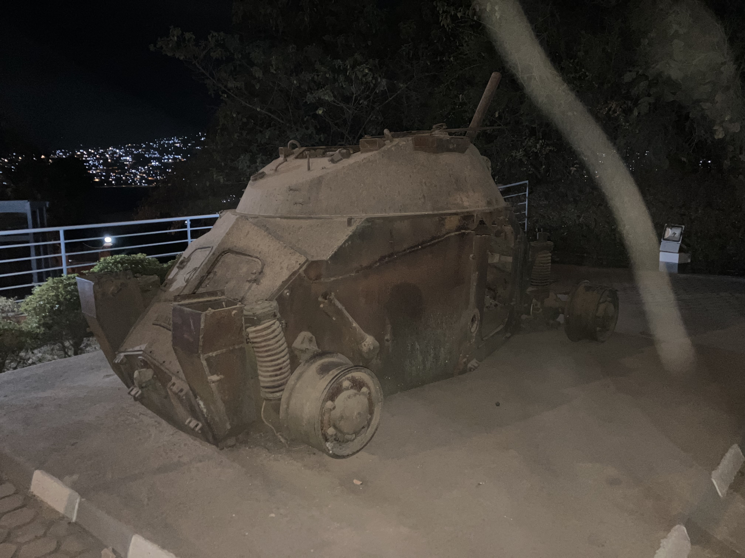
Alpha, Bravo and 59th CMF
Lt General Caesar Kayizari:
  “he [President Kagame] told us that we needed to reach Kigali immediately. We could not get distracted or fight the FAR. Don’t use the main [central corridor] road, but go around it so the enemy does not see us. Other battalions [such as the 7th and 101st CMF] would handle those forces.
Alpha, under Sam ‘Kaka’ Kanyemera reach KFH April 11th at around 4pm and Parliament the following morning (April 12)
  Jacob Tumwine’s Simba Company helped prevent Alpha getting ambushed.
Battle of the Tank

Slide 7
April 8-12
While RPA reinforcement were coming, the 3rd Battalion was alone
  Bravo & 59th face hurdles at Zoko Hill
  April 11 at 11:30 am, UNAMIR observers see Alpha CMF north of Kigali
  When Alpha CMF arrives, Kaka becomes commander of Kigali with Kayizari becoming new commander of the CMF.
  Two companies of Alpha are transferred to 3rd (CHUI was hard hit)
  CHUI Company is relieved from Kimihurura Circle
Some in the FAR, such as Army Chief of Staff, Colonel Marcel Gatsinzi, did hope for end of violence (replaced by Augustin Bizimungu within 10 days)
General Kagame gave UNAMIR & FAR 24 hours to end the massacres (but sent the reinforcements before the deadline)
Hutu extremists such as Dr Theodore Sindikubwabo & Jean Kambanda form new extremist government.
Genocidal massacres throughout Kigali
UNAMIR, ETO, Hotel Des Mille Colline
April 9: 101st CMF reach outside eastern Kigali but told to go back to defend Mulindi
Operation Amaryllis & Operation Silver Back

Slide 8
Mt Rebero
LT Colonel Jacob Tumwine sets forth to take Mt Rebero
Mt Rebero is a tactically vital hill based on its location
Eagle and Simba Companies (300 soldiers) are set forth to take the hill in the late hours of the 11th
RPA seeing the horrors of the Genocide’s affects in Gikondo & Kicukiro
Pass the empty ETO
Discovery of Nyanza massacre
Decision:
  What should Tumwine do when he discovers what happened?
    1.) Leave soldiers behind to protect the survivors (bad choice as he needs all the soldiers he can for the attack on Mt Rebero)?
    2.) Bring the survivors with him (bad choice as he will be bringing them to a war zone)
    3.) Leave the survivors behind (bad choice because Interahamwe will be coming back)
    His decision is vital in understanding how the RPA’s strategy was ending the Genocide rather than political, economic and military control over the country.
While it takes 2 weeks to fully capture the hill, it is mostly under RPA control within a few days
Simba, Eagle and Tiger Company (who came later) depart from the hill once Bravo & 59th CMFs come to relieve them.

Slide 9
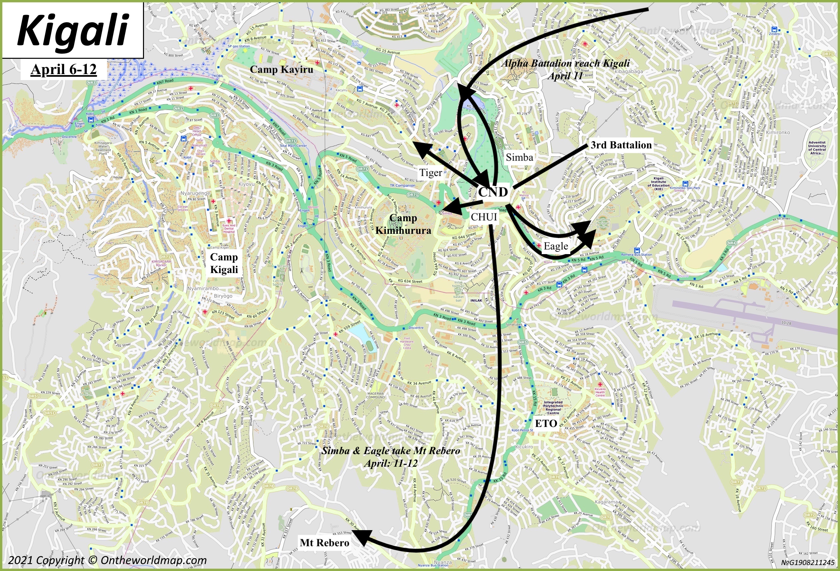

Slide 10
Why is the first week important?
The RPA could have lost the war if anything had gone wrong during the first week.
  3rd Battalion under Kayonga could have collapsed or been defeated
  Alpha, Bravo & 59th CMFs could have been stopped
  Mulindi could have been defeated if 101 CMF did reach back in time
Prior to the arrival of Alpha CMF, this was the strongest the FAR would ever have in terms of military positionality/operations.
FAR’s indecisive strategy began which diverted military operations into different directions.
Once Alpha CMF reached the CND, the war in Kigali changed.

Slide 11

Questions?
Questions?

