Slide 1


Campaign against Genocide War (April)
Dr Jonathan R Beloff

Slide 2
Recap…
Alpha, Bravo and 59th CMF reached Kigali to relieve the 3rd Battalion
  “When the new battalions entered Kigali, there was a goal to get them to make an impact immediately. This was to show to the FAR that the RPA reinforcements arrived and that the war wouldn’t be a quick victory for them” –Lt General Kayonga
3rd Battalion is able to hold off pressing attacks while break-out of CND compound
Capture of Mt Rebero
Tiger Company in the ridge between Nyanza Hill and Kanombe
Genocidal massacres erupt throughout the city/country.

Slide 3
Second Week (April 13-20)
Operation Amaryllis
  RPA: Why did they allow a cease-fire for it?
    1.) Remove foreigners who might become human shields for the FAR/Interahamwe
    2.) Perhaps provide an opportunity for the FAR to stop the massacres
Battle for Mt Jali
  Bravo CMF under Dodo attempt to take the important hill
  Takes until May 20th for hill to be under RPA control
Alpha & 59th take controls over northern half of Kacyiru
  SOS Children’s Village become a new transit site for rescued Rwandans
General Anyidoho (UNAMIR) describes the battlefront:
  “the frontlines between both parties were less than 1000 metres. The situation, along the route from the Hotel Meridien to the Gendarmerie Camp in Kacyiru” (36)
  Kacyiru to the Meridien Roundabout through KN 5 RD reaching Chez Lando in Kissimenti and into Remera.
UNAMIR attempts cease-fires but RPF/A demand end of Genocide first
16th-20th : new wave of genocidal killings in Nyamirambo with urban warfare increasing in Nyamirambo, Kicukiro and Gikondo
  Amahoro Stadium is shelled by FAR leaving to 45 dead
  Camp KAMI shells Parliament from the north hoping to break RPA morale
St Andre rescue operation on April 16th
Lt General Muhire’s 101 CMF leaves Mulindi towards southern Kigali by May
19th: Belgium’s 2nd Commando Battalion withdraws from Kigali

Slide 4
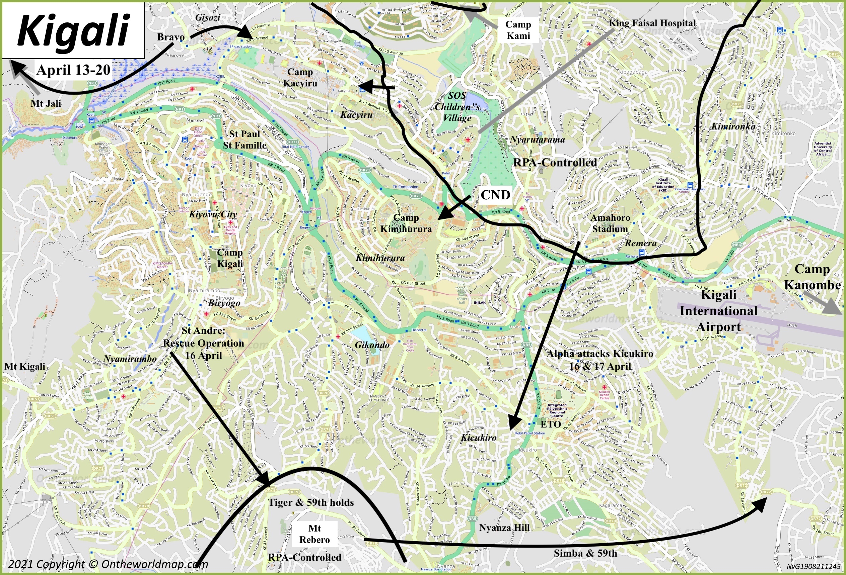

Slide 5
Third Week (April 21-27)
22nd & 24th: Interahamwe enter St Paul & St Famille to find and kill Tutsis
21st: Bravo CMF attempts to take Mt Kigali but struggle against the FAR’s 21st Battalion
UN Security Council Resolution 912 to reduce UNAMIR to 270 soldiers
  Ghana keeps their 800 soldiers with General Anyidoho
RPA continue rescue operations in Nyamirambo & other parts of Kigali
RPA’s 7th and 157th CMF going south and east
RPA’s 101 and 7th CMF attack the city from the eastern town of Rwamagana
FAR Murasira describes the carnage:
  “I saw the genocidal massacres everywhere. Every street had dead bodies, but most [FAR] soldiers didn’t seem to care.”
Beginning of exodus of Rwandans from RPA safe zones to outside of Kigali
25th: Battle 300 meters east of Remera

Slide 6
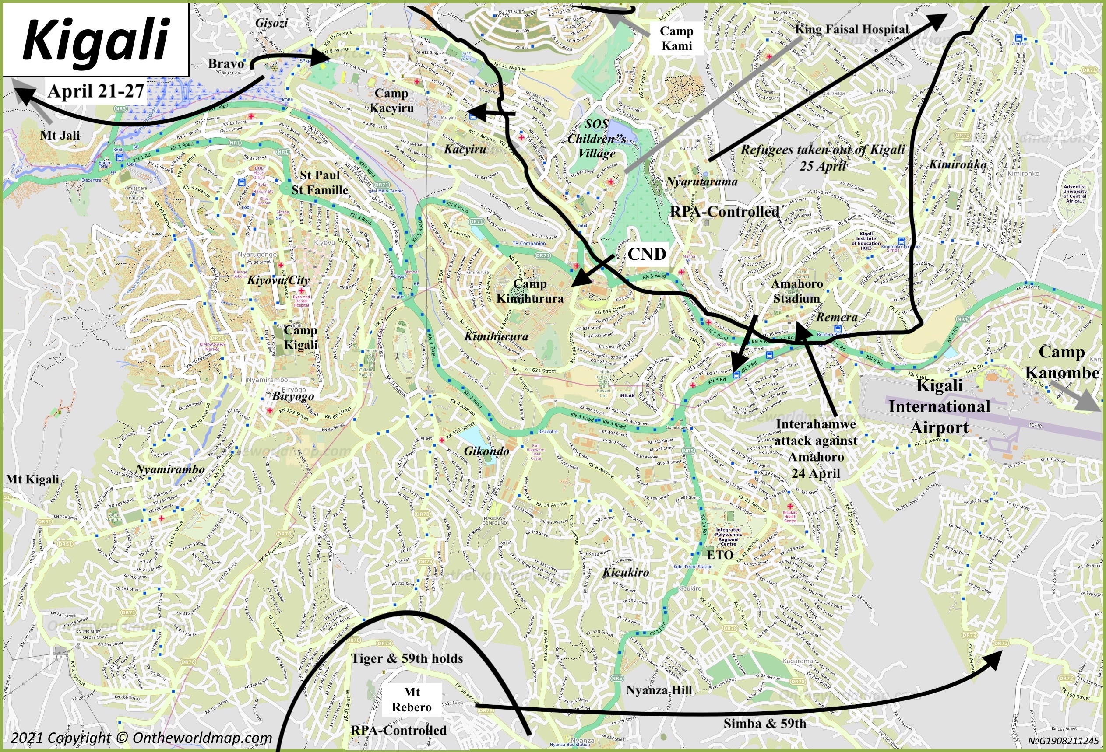

Slide 7
Final April Days (28-30):
General Augustin Bizimungu takes leadership of the FAR
  What is the strategic goal of the FAR?
RPA’s 101 & 7th CMF roughly 30 km southeast of Kigali
  UNAMIR believes it’s just a matter of time until the RPA win & notice difference in morale
Camp KAMI falls to the 21st CMF and RPA are only a few km of Camp Kanombe
RPA secures northern routes to Kigali and tactical locations in Kacyiru, Nyarutarama and Gacuriro
King Faisal Hospital controversy

Slide 8
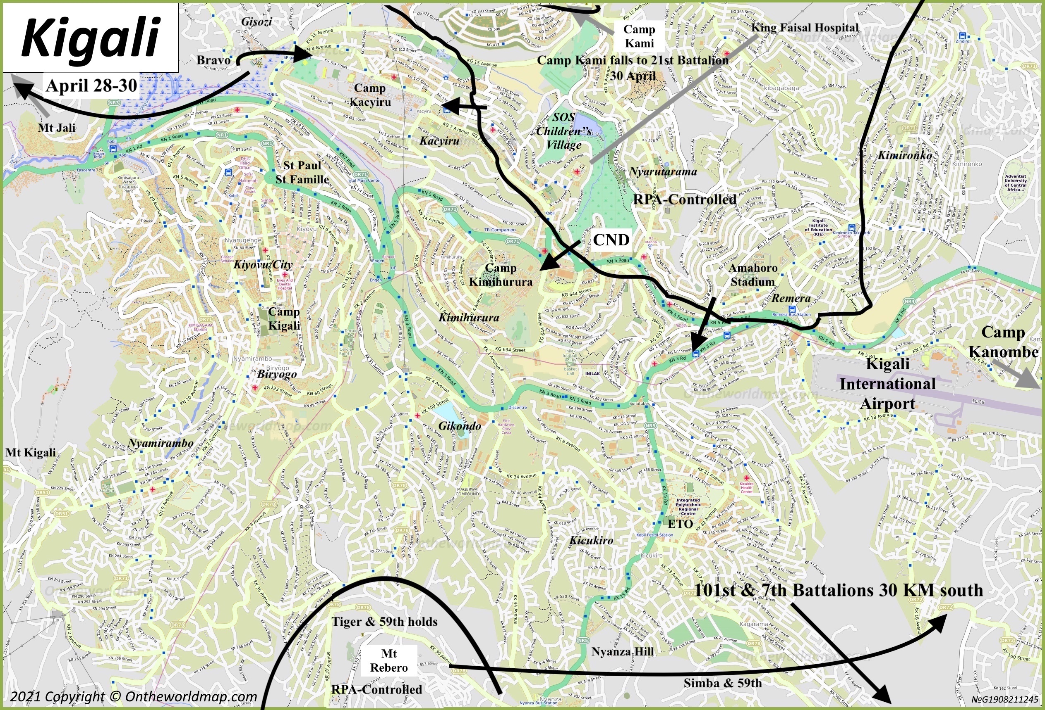

Slide 9

Questions?
Questions?

