Slide 1


Campaign against Genocide War (June-July)
Dr Jonathan R Beloff

Slide 2
Recap…
Capture of Camp Kanombe 22/23rd May
  Akin to the arrival of Alpha CMF, the RPA’s military victory was a major moment in the war.
Continued fighting:
  Kiyovu, Nyamirambo, Gikondo and Kimihurura
RPA rescue operations continue
FAR is unable to recapture Mt Rebero

Slide 3
June 1-8:
FAR attempt to retake Mt Jali
  Interahamwe and new FAR recruits are unable to dislodge the RPA
2nd: RPA’s 59th & 21st CMF focus on infiltrating Nyamirambo while Alpha CMF inches more into Gikondo
FAR still controls:
  Western Kacyiru, Kinamba, Nyamirambo and most of Gikondo with Presidential Guard at Camp Kimihurura
  Morale is in decline
3rd/4th: As the RPA has mostly surrounded Kigali, its attention begins to concentrate on encircling Camp Kimihurura
Western neighbours of Kigali (Nyabugogo, Nimisagara, Nyamabuye, Agateko and etc) erupt from shells, mortars and heavy artillery.
5th: While the RPA tries to loosen the FAR’s grip on Kacyiru, Kimihurura and Nyamirambo, the FAR is trying to delay the inevitable
  Gikondo falls to Alpha CMF with minor pockets of resistance
6th: FAR attempt a counter-offensive in southern Kigali but the 101, 7th and 157th CMF stop them causing FAR to flee
7th: Gaddafi Mosque in Nyamirambo falls to the 21st CMF
  FAR respond with another failed attempt to take Mt Rebero
8th: Fighting continues in Nyamirambo and Gatsata neighbourhoods with intense fighting at Kimihurura Circle.

Slide 4
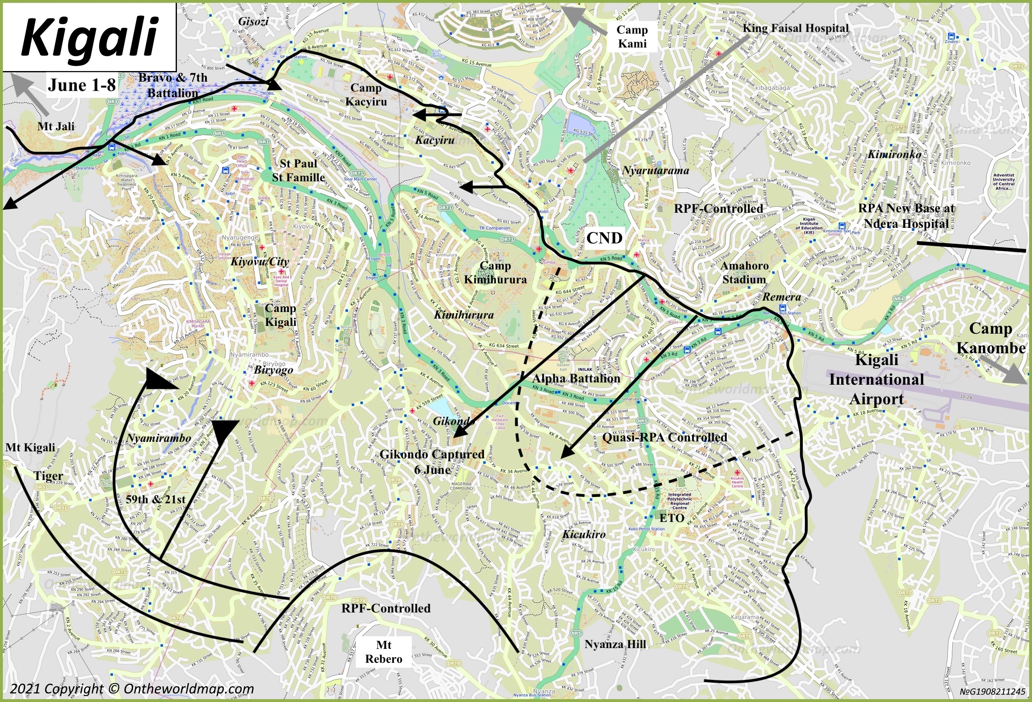

Slide 5
June 9-15:
9th: FAR attempt to use its artillery and mortars against the RPA’s Bravo CMF in Gisozi with only minor effects
  Kisimenti is attacked around 10:50am with a shell hitting UNAMIR’s headquarters
  RPA push into Kibugiza and repel an attack on Gikondo
RPA surrounds Nyamirambo and Nakabanda with the 59th CMF
  Nyamirambo Catholic Church is attacked with Priest Otto Mayer unable to stop the Gendarme and Interahamwe with 170 Tutsis killed
FAR achieves a minor victory at Gatsata but not for long (10th)
  Over-reliance on defensive tactics –Minister Marizamunda
11th: FAR controls Kiyovu, Nyamirambo and parts of Kicukiro, western Kacyiru’s neighbourhood of Kinamba and southwestern side of Kimihurura.
12th: Continued fighting with 21st CMF inching towards the Islamic neighbourhood in Nyamirambo and Biryogo
13th: Gitarama falls and 101 are told to refocus on southern Kigali
15th: Andrew Kagame’s unit (from parts of the 3rd battalion and the 59th) continue fighting the FAR’s 17th Battalion near Mt Kigali
  Overall: half of Nyamirambo is under the control of the RPA’s 21st & 59th CMF

Slide 6
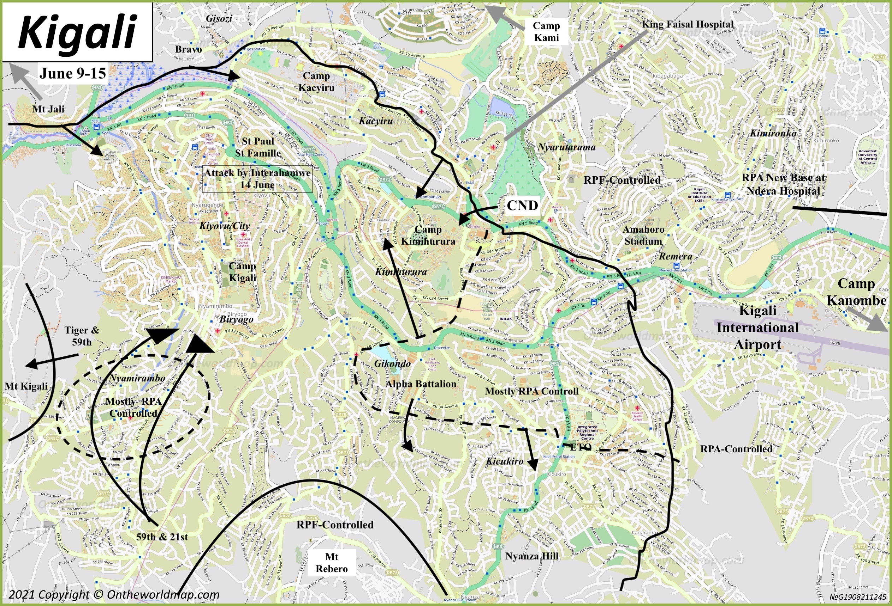

Slide 7
Rescue of St Paul (June 16-17):
  General Kagame had ordered all battalions/CMFs to draft ways to save the 2000+ there.
    “He [General Kagame] ordered Bravo and other battalions to get to the church, but many early attempts failed” –Lt General Kayonga
  17th at 1am, three platoons (90 soldiers) from Bravo left Gisozi.
    Two platoon responsible for distracting Camp Kacyiru (assault on their flank)
    Third platoon would infiltrate FAR-controlled Muhima and reach Kiyovu roundabout (KN 1 Road)
    Some of the third platoon went to the St Famille and St Paul compounds to inform and move people.
    Not a full success as some at St Famille didn’t believe they were truly the RPA. Also, Camp Kacyiru didn’t focus their attention only on the two platoons.
    Soldiers guided the people down the hill and to Bravo’s position in Gisozi
  By 5:30 am, most refugees reached Bravo’s position
  At 11:00 am, Interahamwe entered St Famille and killed 150 people until an FAR commander told them to retreat.

Slide 8
June 16-22:
17th: FAR at Mt Kigali faced greater pressure
  FAR’s control remained in the north half of Nyamirambo, Camp Kimihurura, Kiyovu and city centre but frustrations grew.
    Minor consolation of FAR territory in Nyamirambo
20th: All FAR & Interahamwe forces removed from Mt Jali
New intense fighting around Mt Mburabuturo
Bravo CMF begins encircling Camp Kacyiru by controlling more of the ridge.
21st: FAR and Interahamwe gain a morale boost thanks to France and the upcoming Operation Turquoise
  UN Security Council Resolution 929
22nd: RPA launch a new offensive against FAR at Kimihurura Circle and break the stalemate at Village Urugwiro

Slide 9
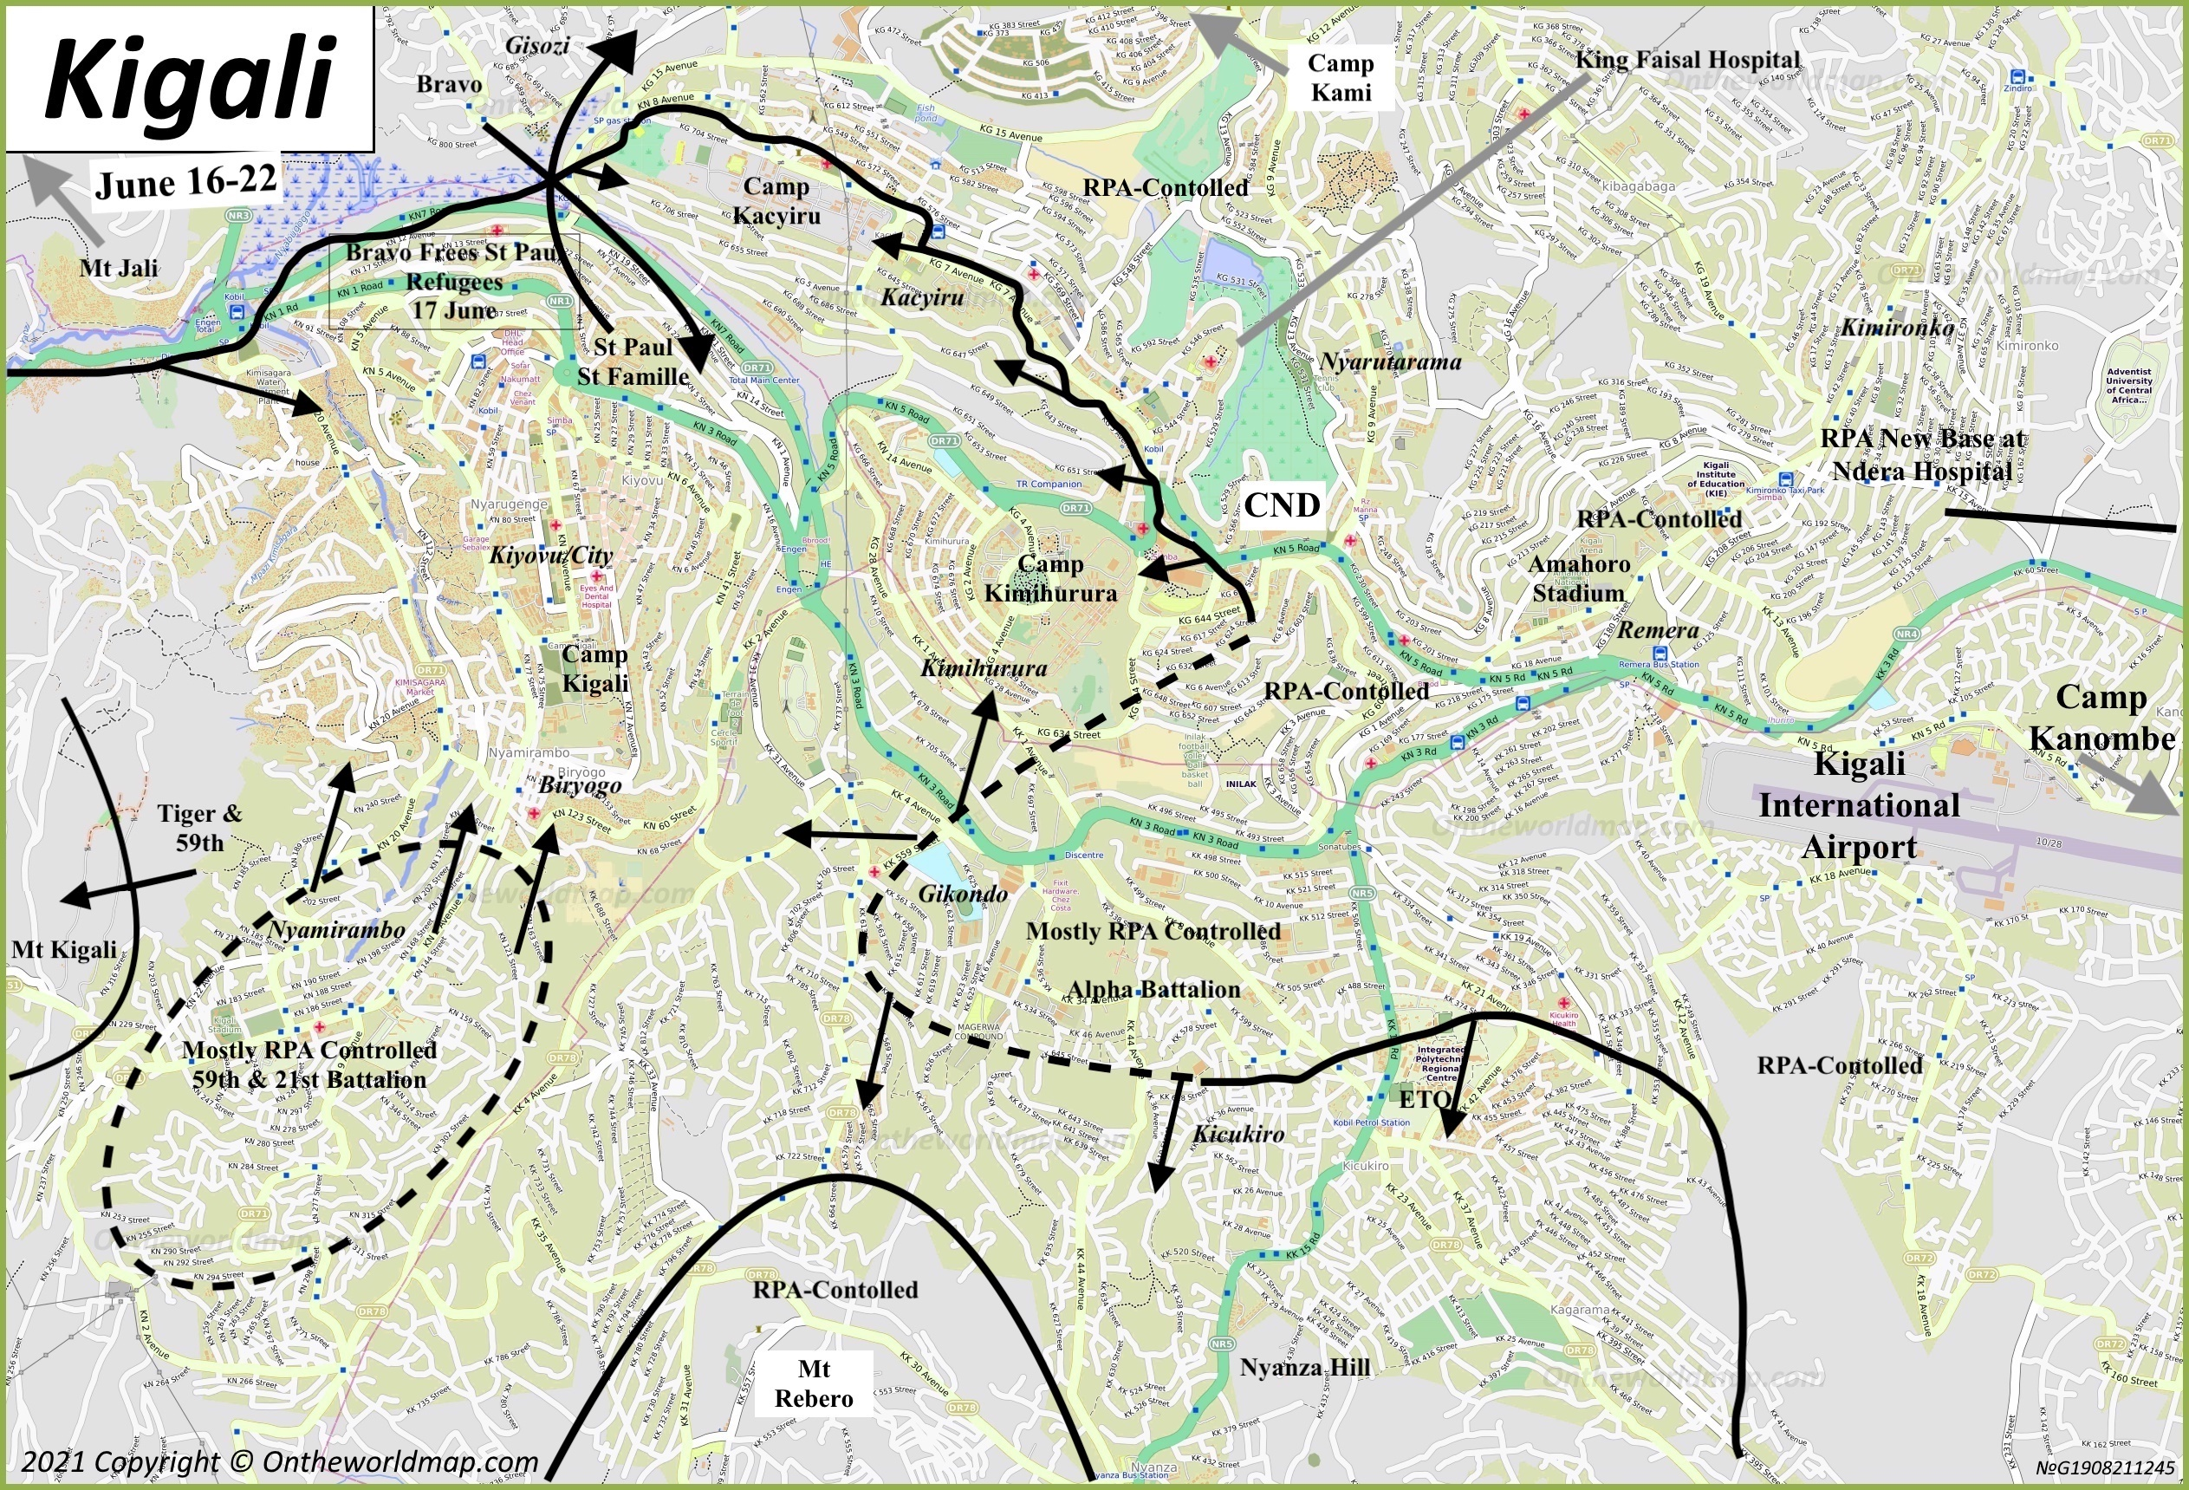

Slide 10
June 23-30:
B.G. Evariste Murenzi experience with the Interahamwe
  It illustrates the significance of divide & lack of strategy within the FAR & genocide regime
24th: Genocide government organises a France appreciate celebration in the city centre
  RPF counter rally in Kabuya
14th-28th: Battlefields at Kacyiru and Nyamirambo become inevitable RPA victories or when rather than if
  Continued fighting at Village Urugwiro, Kimihurura Circle, Nyamirambo and city centre
  FAR adopt more defensive postures in Kimihurura and its pockets of resistance in western Gikondo
Dash towards Butare for the 157th CMF

Slide 11
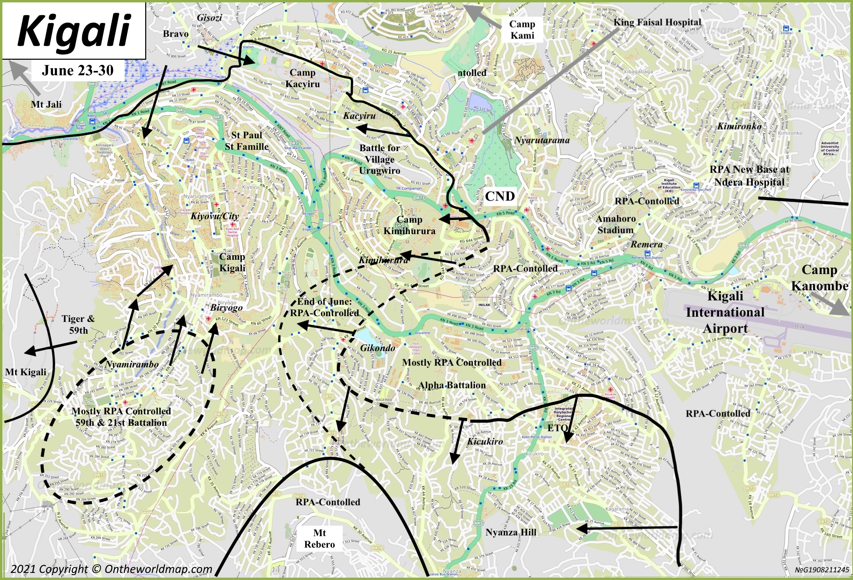

Slide 12
July 1-4:
1st: Minor changes from the past few weeks with battles raging on around Camp Kacyiru, Kimihurura Circle and Kiyovu
  FAR is limited to mortars, artillery shells and small arm fire
  Urban warfare is intense
  PM Kambanda now calls for a cease-fire and negotiations
RPA’s focus:
  Greater focus on military bases, Village Urugwiro & Mt Kigali
  Lt General Kayizari (Alpha) becomes determined to defeat Camp Kimihurura
FAR decides a retreat:
  In the evening of July 3rd, Camp Kimihurura is told that they along with Camp Kigali and Camp Kacyiru will retreat in the night.
Kegel (2019, 266) describes the end:
  “Early [the] next morning, RPA sentries noticed that the positions in front of them seemed abandoned. As soon as they realised the FAR was withdrawing, the RPA attacked even harder to turn the retreat into a rout. Alpha Mobile entered the Presidential Guards Camp [Camp Kimihurura] at 6:30 on the morning on 4th July.”
July 4th:
  Alpha CMF breaks through Kimihurura Circle & takes the base
  Bravo takes Camp Kacyiru
  21st and 59th CMF capture Biryogo and head towards Kiyovu/city centre
  59th CMF takes Mt Kigali
Afterwards:
  Bravo & 7th CMF are ordered to follow the retreating FAR.
  Other CMF (Alpha, 21st, 59th) ordered to conduct clean-up operations

Slide 13
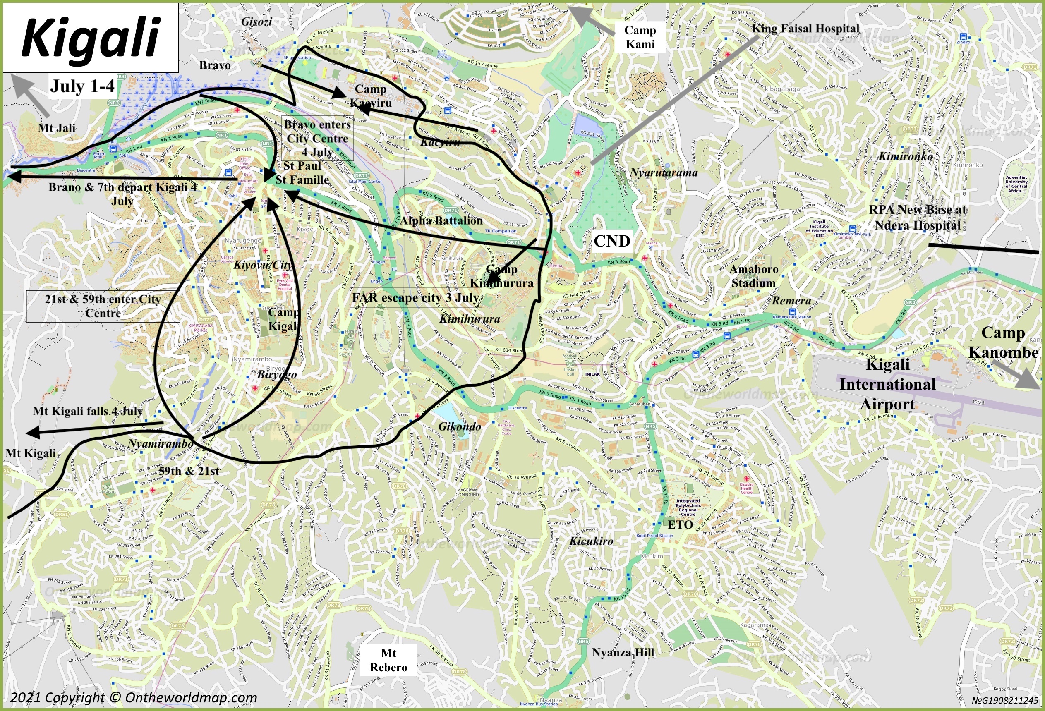

Slide 14
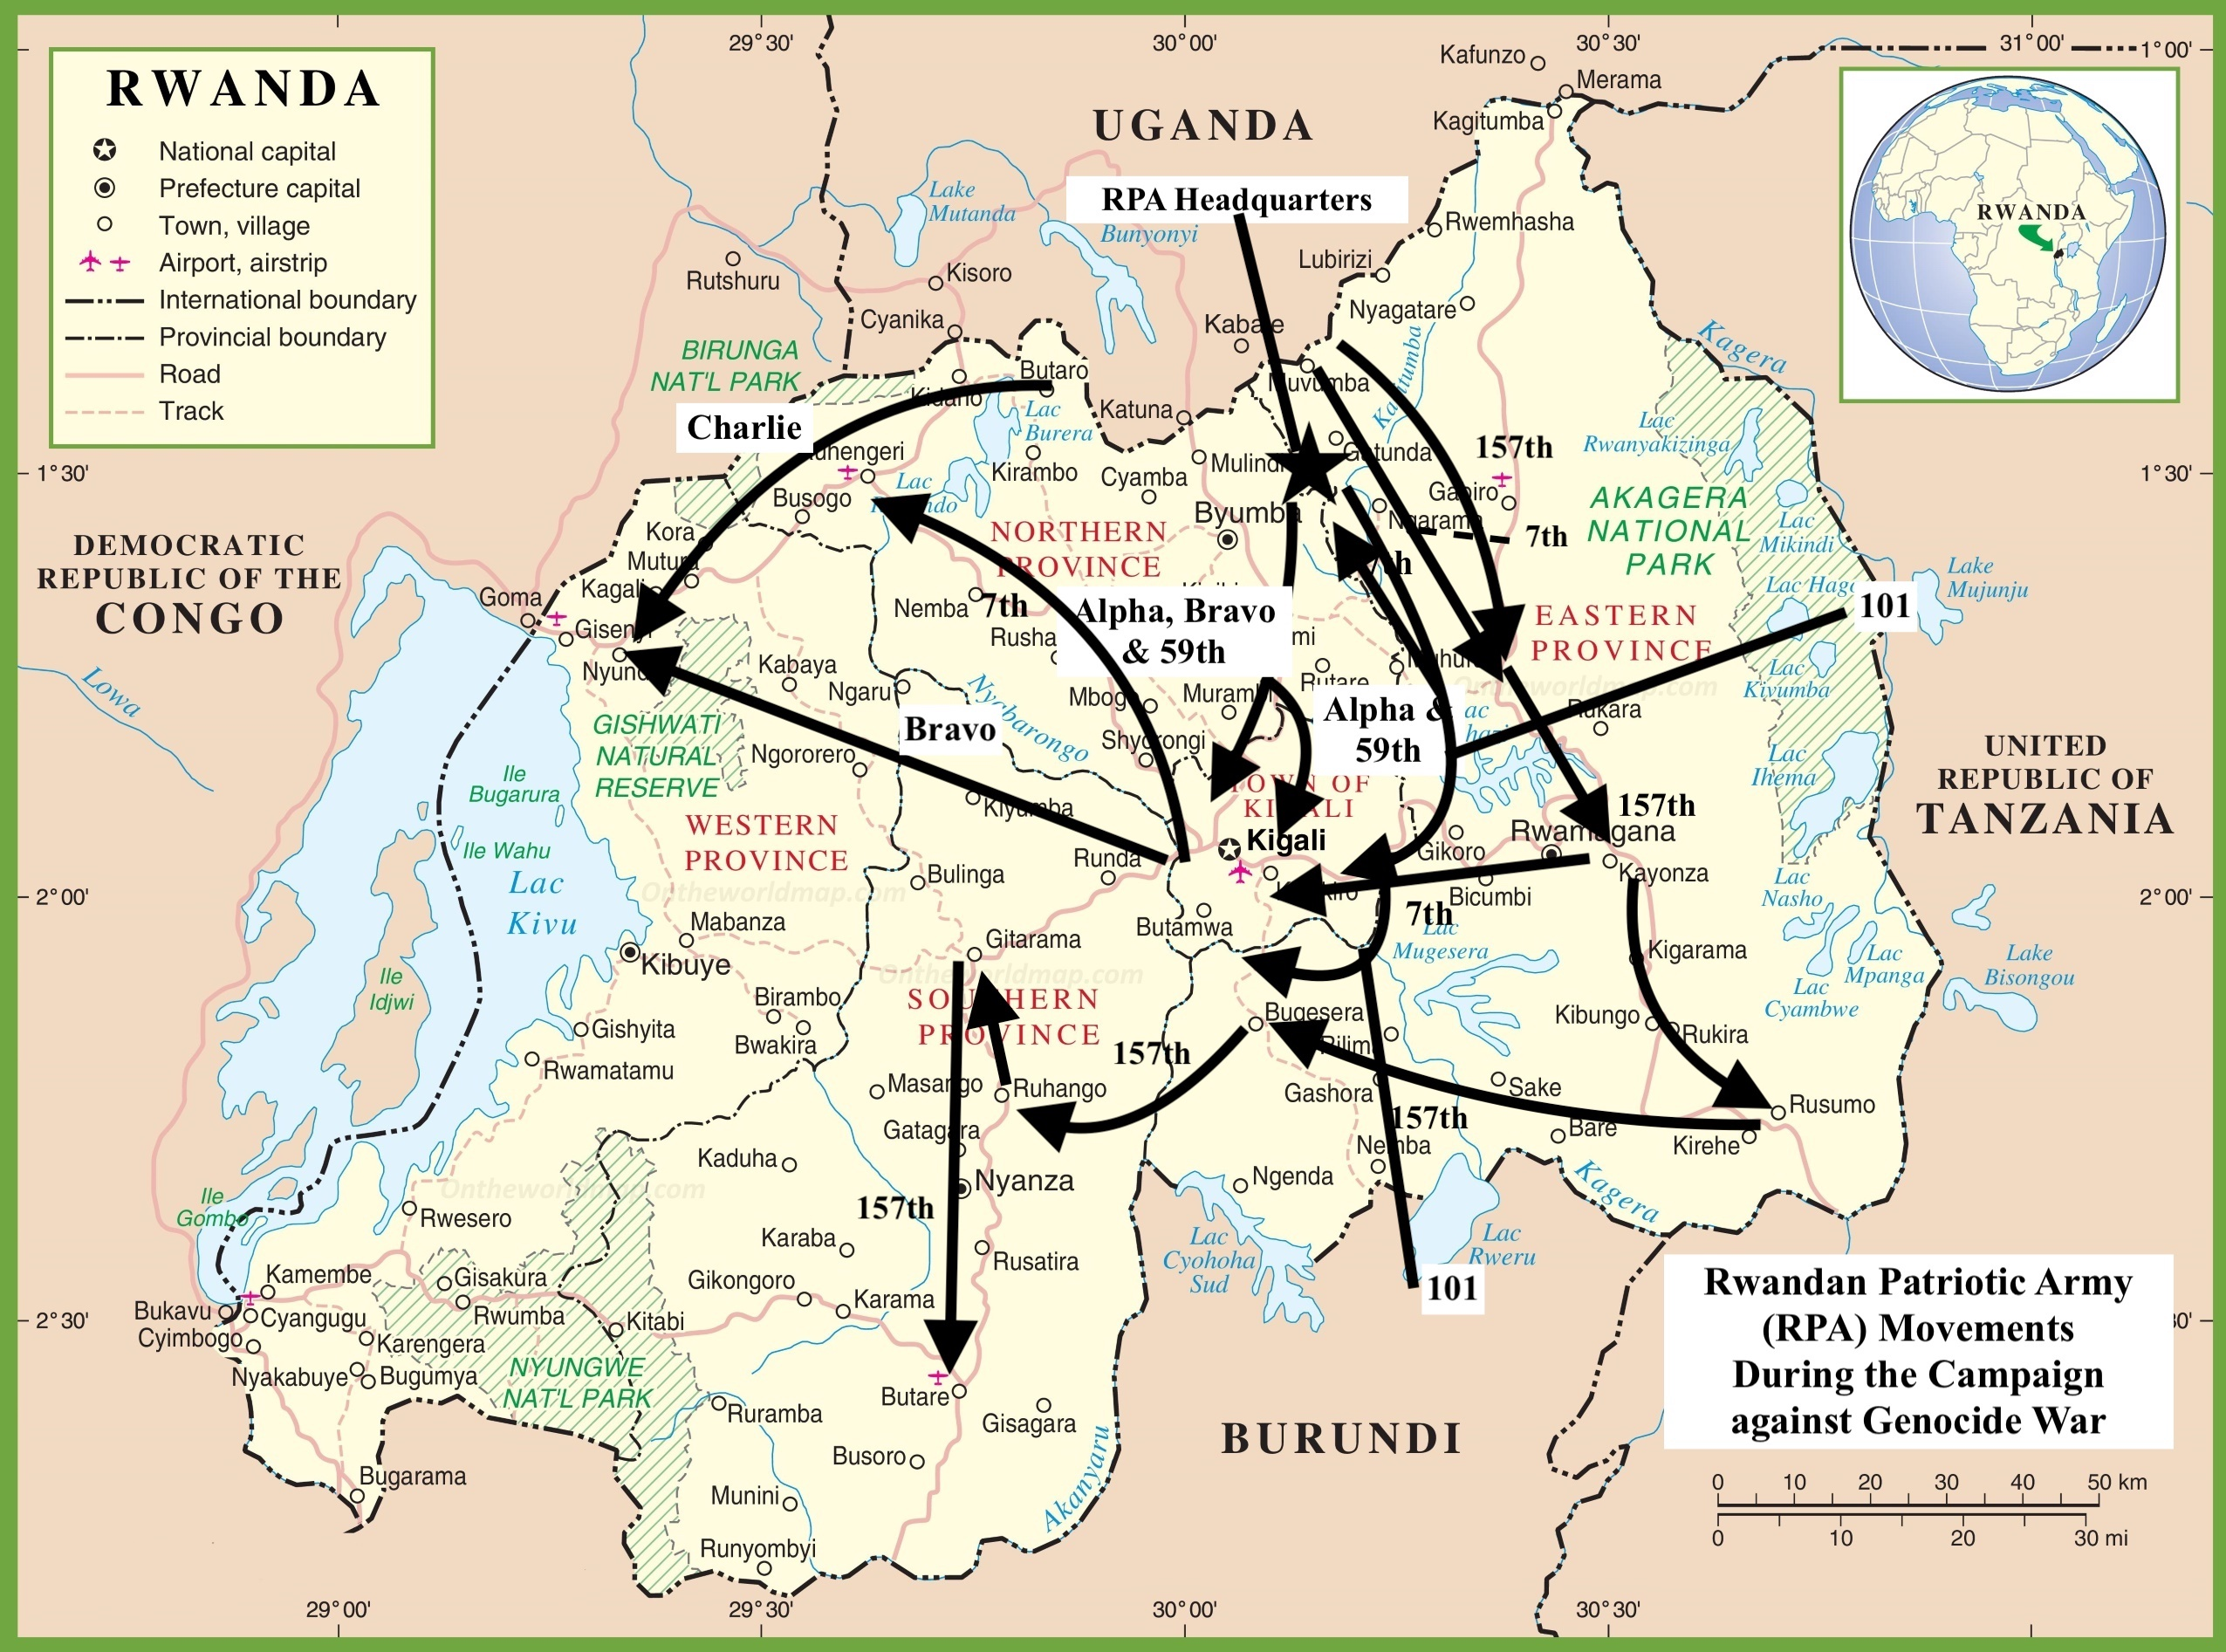

Slide 15

Questions?
Questions?

