Slide 1


Campaign against Genocide War (May)
Dr Jonathan R Beloff

Slide 2
Recap…
RPA CMF in Kigali: Alpha, Bravo, 59th, 21st, 101st and 7th
Frontlines: Kacyiru, running along RN3 past CND and east towards Remera
  Mt Rebero & Nyanza Hill under RPA control
  Gisozi partially under Bravo CMF
Fierce battles in: Gikondo, Kicukiro, Kanombe & Mt Jali/Kigali
RPA humanitarian operations:
  Guerrilla tactics by squads or platoons to save people
FAR rid itself of moderate Hutus

Slide 3
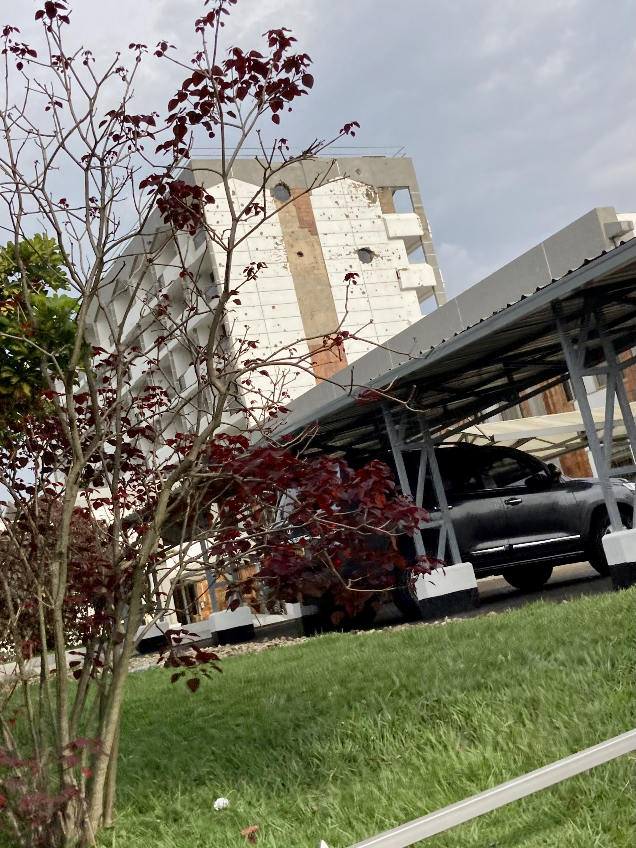
May 1-4:
UNAMIR’s base is still protected by an RPA platoon
1st: Small gains by capturing Egyptian embassy in Kacyiru
  100 wounded in shelling at St Famille
RPA’s 157th and 101st gains in east/south (Bugesera and Gato)
2nd-5th: FAR launching shells/mortars at RPA position (CND)
  The warfare is similar to WW1 in terms of barely changing frontlines
  Fighting increased in Kisimenti & airport
  RTLM announces ‘clean-up day’
7th CMF reached Kigali proper

Slide 4
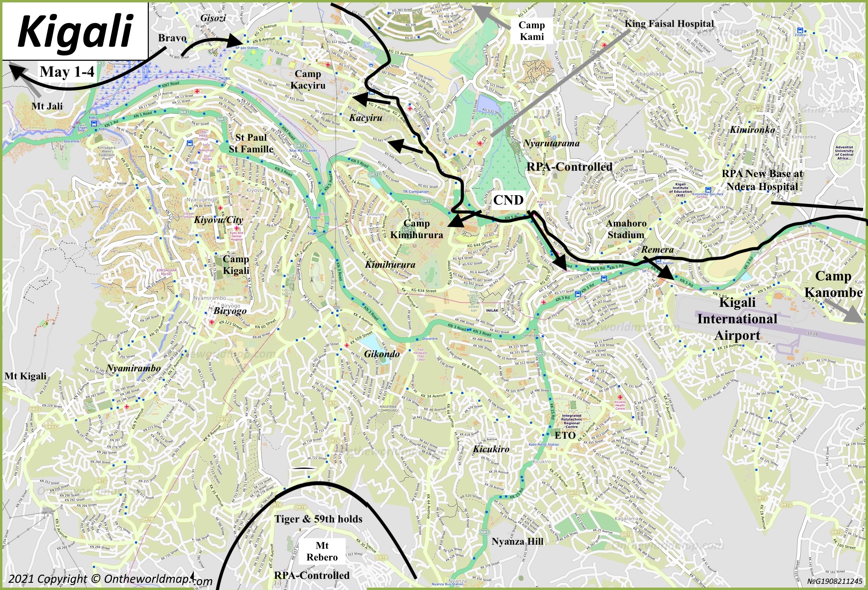

Slide 5
May 5-11:
7th: RPA had largely swept across the Nyabarongo River
  101st focus is rooting out Interahamwe
Fighting and rescue operations in Gikondo, Kicukiro and Rwandex
Pressure on Camp Kanombe
  FAR brings heavy artillery from Gitarama
Roughly a fourth of Kigali has been liberated
Lt General Mubarakh:
  “the akazu wanted their soldiers to focus more on killing Tutsis than the war effort. There was the belief that if enough Tutsis died, the RPA would give up.”
9th: RPA’s 59th and 21st CMF begin taking positions around Nyamirambo
  UNAMIR loses Pte Mensah Baidoo of Ghana from a FAR shell
10th: New RPA operation in Remera
11th: Battles throughout the city and fighting in Bugesera (and north of Gitarama)
  Some FAR commanders begin to desert after failures to stop the RPA’s 157th CMF from crossing the Akanyaru River
  21st CMF shelling of Nyamirambo and Bravo focusing on capturing western parts of Kigali

Slide 6
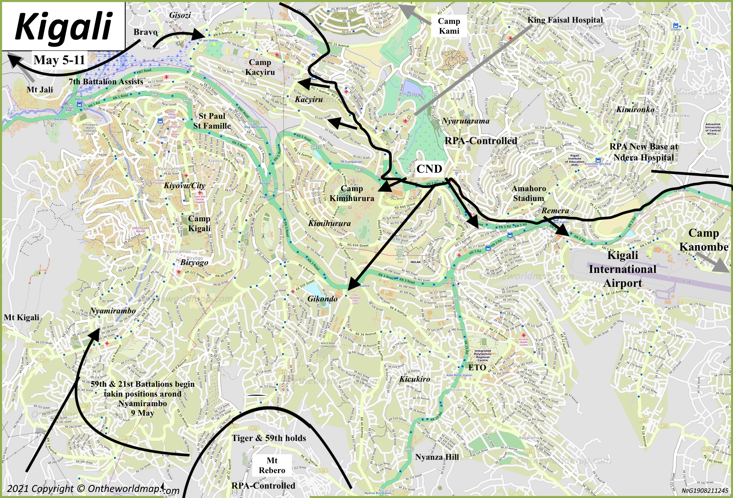

Slide 7
May 12-18:
RPA’s capture of Kabuga in eastern Kigali (a few km from Camp Kanombe)
  Lt Colonel Tumwine receives orders from General Kagame to allow a humanitarian corridor for civilians to escape before the upcoming battle for Camp Kanombe.
General Bagasora attempts to take Mt Rebero from RPA on 16th
RPA cut most links between Kigali and Gitarama (Augustin Bizimungu is cut off from the genocide government which causes confusion)
Fighting at Kimihurua Circle continues with greater intensity
In France, Minister Marizamunda hears about the Genocide
RPA’s 101st and 157th CMF reaches outskirts of Gitarama
18th: New FAR recruits (10,000) come into Kigali but most are Interahamwe.
  The recruits were relatively unsuccessful in displacing the RPA despite vicious battles across Kicukiro, Remera and eastern parts of Kigali

Slide 8
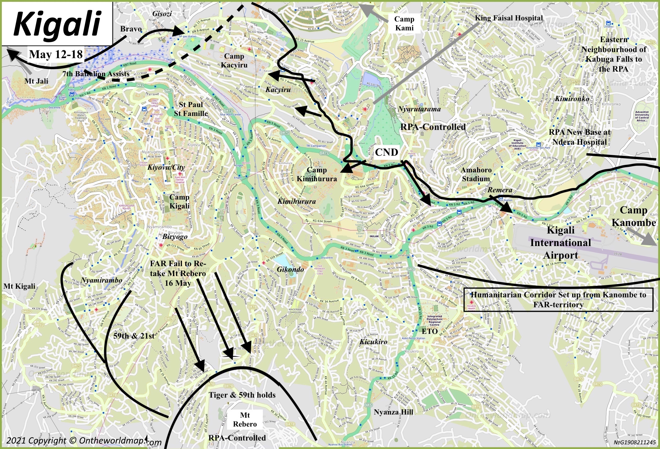

Slide 9
May 19-25:
Kigali is nearly encircled and the battle for Camp Kanombe ramps up
FAR begin using a 37 mm anti-aircraft guns for ground warfare
20th: RPA’s 7th CMF, along with Bravo, capture Mt Jali
  They effectively take control over the hill and the surrounding north-western neighbourhood
Simba Company blocks southern roads from Kanombe to Kiyovu
  Prevents FAR’s resupply of Camp Kanombe
Prunier (1997, 255) estimated around 60,000 bodies have been picked and buried of genocide victims in Kigali
RPA attempt to take the southern Kigali hill of Mt Butamwa but are unable to with 59th CMF losing up to 50% of its troops
Capture of Camp Kanombe on May 22/23rd
  After the capture, Tiger Company (Under Andrew Kagame) travels to western part of the city near Mt Kigali
24th: While most of the frontlines remained the same, the attacks on Mt Rebero ceased but Interahamwe attacks against RPA increase
25th: Changes within the RPA’s structure
  Kayonga is transferred to Bravo CMF

Slide 10
Capture of Camp Kanombe
Fighting for the area really began taking place on April 30th
  Heavy fighting around the plane crash site
18th May: UNAMIR notices that fighting is intense in the Kanombe area
Two Companies from the 3rd Battalion (Eagle and Tiger) and the 7th CMF (from the east) meet to take over the Busanza road.
  Alpha and 21st CMF are also involved in taking Camp Kanombe and the airport
  RPA’s Andrew Kagame is ordered to take KN 3rd to Kanombe
  7th CMF was the lynchpin in dislodging the Para-Commandos
May 21st: FAR attempts a counterattack to break the RPA’s control in order to gain supplies, troops and move FAR family members.
  The passageway remained open from before but only for civilians.
    "This was done because it lessened the troops [suspecting Interahamwe or civilian clothed soldiers would flee as well] the RPA would have to fight later, the FAR left equipment behind, caused confusion and chaos that demoralised the enemy soldiers” –Lt Colonel Tumwine
  UNAMIR establishes a temporary cease-fire for the evacuation of 156 injured persons from the military site (800 soldiers and thousands of civilians flee)
May 23rd: Camp Kanombe is taken
  FAR leave behind: 37MM anti-aircraft guns, Browning Machine Guns, 60MM mortars, small arms ammunition and vehicles

Slide 11
Camp Kanombe Capture Response:
Officially, the military response was to FAR shelling of CND, Meridien Hotel, UN HQ and King Faisal Hospital. However, the RPA’s capture of Camp Kanombe led to different expressions of anger.
Interahamwe:
1.) Disorganisation in eastern Kigali with theft beyond what was before.
2.) Attacking Mille Collines and other parts of the City
3.) Kacyiru: More daring in attacking civilians
Important to note that much of the Interahamwe were called by the RTLM radio of the need to speed up the killings.
FAR troop morale collapses:
  1.) Booh-Booh writes of how UNAMIR saw the troop morale collapse after the fall of the military camp.
  2.) FAR focus on consolidating their current holdings (specifically in the tactical important Camp Kimihurura) in other parts of the city but are moving civilians out.
  We see the difference between ‘civilian’ militias from the military establishment who within a few weeks would lose the defacto capital city of Gitarama.

Slide 12
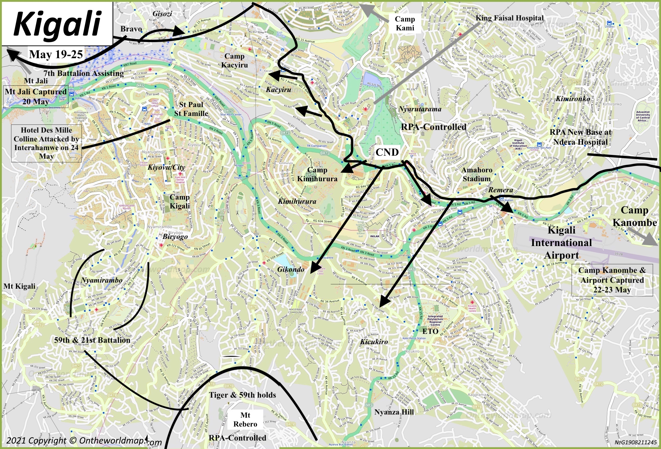

Slide 13
May 26-31:
3rd Battalion is for the most part dissolved and brought into other CMFs.
  Most were either taken by Alpha, Bravo or independent such as Andrew Kagame’s company
Securing of Gisozi and pockets of resistance at Mt Jali and battles in western Kacyiru
Beginning to plan the rescue for St Paul & St Famille
FAR’s only operational response was shelling RPA locations at the CND, Meridien Hotel, KFH and Amahoro Stadium.
  Vicious fighting at Kimihurura Circle continues
Temporary cease-fire on 27th May for a prisoner exchange
  Group of Neutral Military Observers (GOMN) join UNAMIR to talk to refugees at different sites (St Paul, St Famille, Mille Collines, etc) about were to be sent
  28th: Trucks of refugees from Hotel Des Mille Colline leave for RPA territory
Lt General Muhire’s 101st CMF sends three companies to seize the Mugina to cut the FAR supply lines from the south
30th: Interahamwe leaders visit Kiyovu to promote genocidal killings
31st: Alpha CMF gains territory in Kimihurura in its encirclement tactic
  Capt Mbaye Diagne of Senegal dies by the Kigali Night Club on KN 7 RD

Slide 14
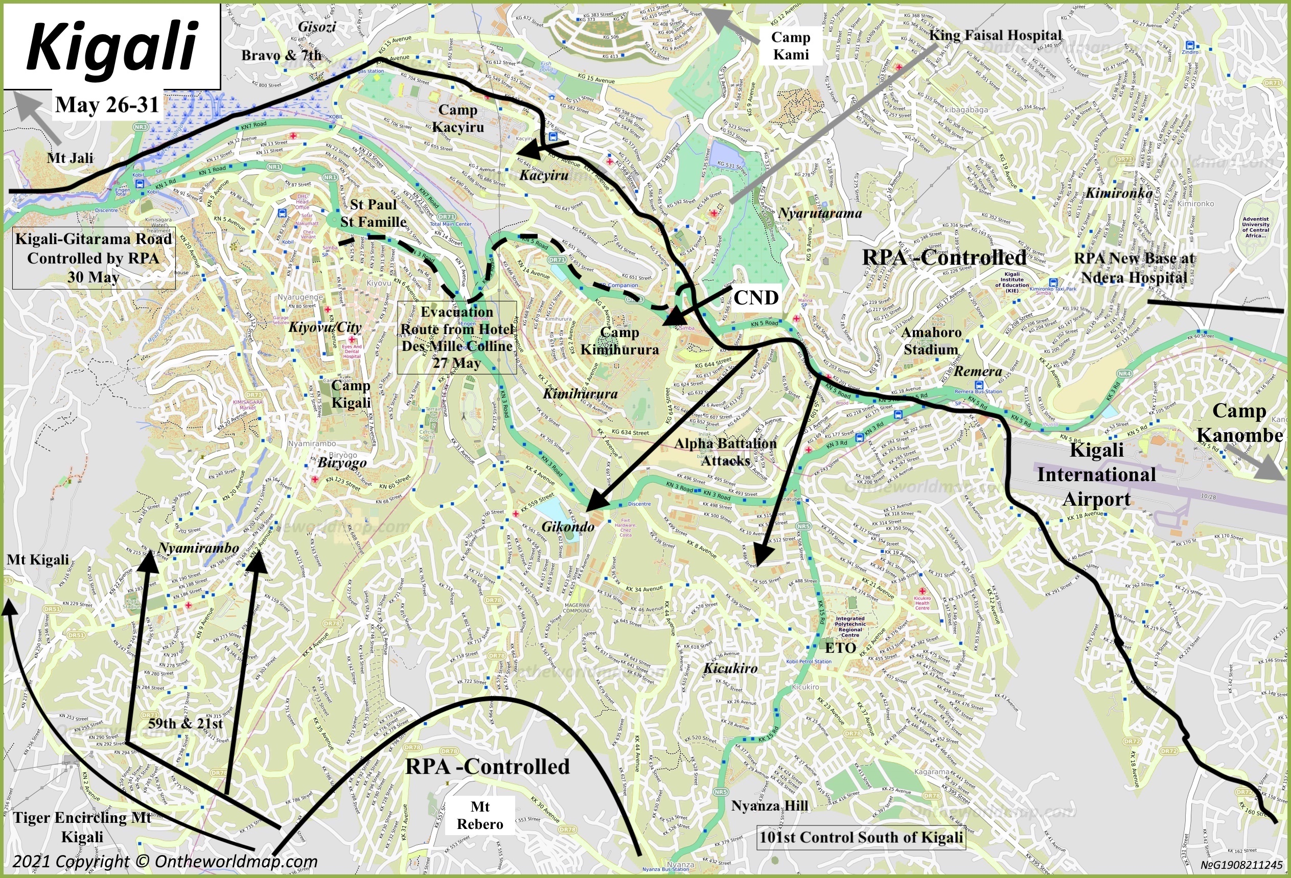

Slide 15

Questions?
Questions?

